Slide 1



PROBLEM, PURPOSE AND VALUES
AZERBAIJAN RESEARCH SOCIETY
Research Foundations
& Literature Review
From curiosity to evidence, collaboration and publishable questions in 2026
Presenter
Dr. Sabrin Ali Azim, PhD
Educational material prepared by Dr. Sabrin Ali Azim. Please cite/acknowledge when reused.

Slide 2
BY THE END, YOU SHOULD BE ABLE TO
Not just know research — start acting like a researcher.
1
Transform a broad topic into a focused research question
from “AI in medicine” to a searchable, answerable question
LIVE CHAT PROMPT
2
Build two objectives and one hypothesis or expectation
depending on whether the study is quantitative, qualitative or mixed
Which skill do you need most today?
3
Create a keyword architecture
Type one number in the chat:
1 Question • 2 Keywords
3 Literature • 4 Article reading
5 Collaboration
concept blocks, synonyms and Boolean logic
4
Read an article like a researcher
identify aim, variables, design, evidence gap and limitations
5
Design one collaboration angle
connect AI, law, medicine, economics, engineering or life sciences
AZERBAIJAN RESEARCH SOCIETY • Research Foundations 2026
02

Slide 3
LEARNER PROFILE MATTERS
One methodology. Many research languages.
Computer Science / AI
30%
DESIGN RULE
General principle
+ field-specific examples
= better engagement
Engineering
25%
Life Sciences / Chemistry
25%
Economics / Business
15%
That is why we will move between AI, law, medicine, economics, engineering and life sciences.
Other / unclear
5%
Source: ARS applicant profile summary discussed for this cohort (n=20).
AZERBAIJAN RESEARCH SOCIETY • Research Foundations 2026
03

Slide 4
A research problem is no longer inside one discipline.
RESEARCH IN 2026
Law / ethics / trust
Clinical / human problem
RESEARCH QUESTION
Data / technology
Economics / policy / access
The quality of a research question is partly the quality of the conversation it can create.
AZERBAIJAN RESEARCH SOCIETY • Research Foundations 2026
04

Slide 5
“Research begins with curiosity— stay curious, structure your questions, and the science will follow.”
Curiosity
Question
Design
Evidence
Change

Slide 6
Research Radar 2026
Your field is not a label. It is a set of unanswered problems.
LIVE POLL
What is the most urgent research topic in your field this year?
sustainability
Medicine
Law
Engineering
sustainable materials
sensors
energy
AI diagnostic trust
patient safety
clinical workflow
AI liability
privacy
consent
health & society
AI & data
Economics
AI / CS
Life sciences
insurance access
cost-effectiveness
resource allocation
bias
explainability
model safety
biomarkers
omics
reproducibility
law & policy
materials & tech
Interaction: write in chat → “My field + one problem worth researching.”
Prompt inspired by 2026 trend clusters: AI governance, sustainable materials, digital health, data ethics and interdisciplinary policy.
Azerbaijan Research Society • Research Foundations 2026 • Dr. Sabrin Ali Azim

Slide 7

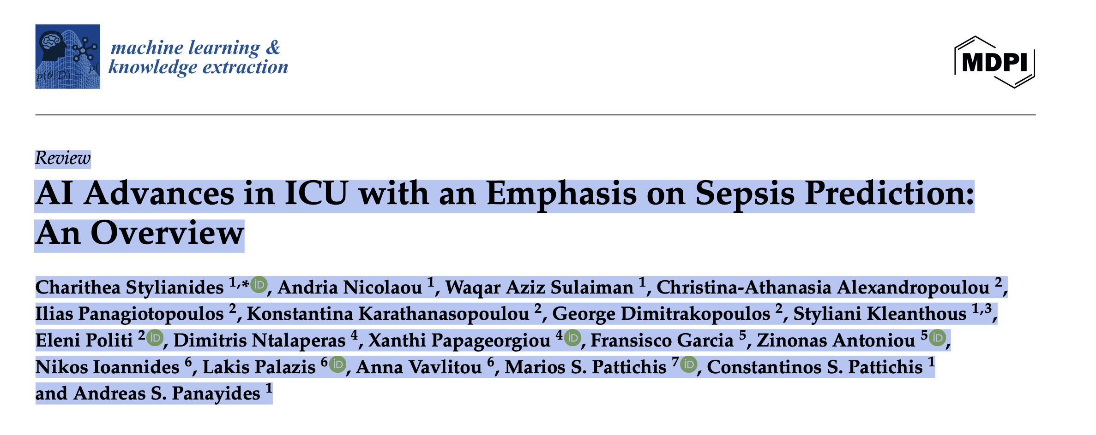
What Turns Curiosity into Discovery?
AI predicts sepsis before ICU admission — Revolution or Risk?

Slide 8
A Trend Is Not Yet a Research Topic
A trend becomes publishable only when it is narrowed into a gap, variable, population and method.
Trend
→
Problem
→
Gap
→
Question
→
Evidence
Weak topic
Researchable question
“AI in healthcare”
Too broad. No population. No outcome. No measurable problem.
“How does explainable AI feedback affect clinician trust and diagnostic accuracy in emergency triage?”
Professor rule: if your title can belong to 1,000 papers, it is not yet your research topic.
Research methodology principle: a topic must be converted into a specific, feasible, testable or answerable research question.
Azerbaijan Research Society • Research Foundations 2026 • Dr. Sabrin Ali Azim

Slide 9
Why Some Topics Receive Citations
Citation impact is quality meeting need, visibility, timing and community.
Growing field
CITATION
ENGINE
Urgent problem
Clear keywords
Reusable methods/data
Right article type
Interdisciplinary audience
Topic growth matters
Collaboration expands audience
Open data helps travel
Fast-growing topics show citation advantage across broad disciplines.
Co-authorship and international networks often increase visibility.
Shared data strengthens transparency, reuse and collaboration.
Sources: Sjögårde & Didegah 2021; Thelwall 2023; Alahdal et al. 2026; Dorta-González & Dorta-González 2022.
Azerbaijan Research Society • Research Foundations 2026 • Dr. Sabrin Ali Azim

Slide 10
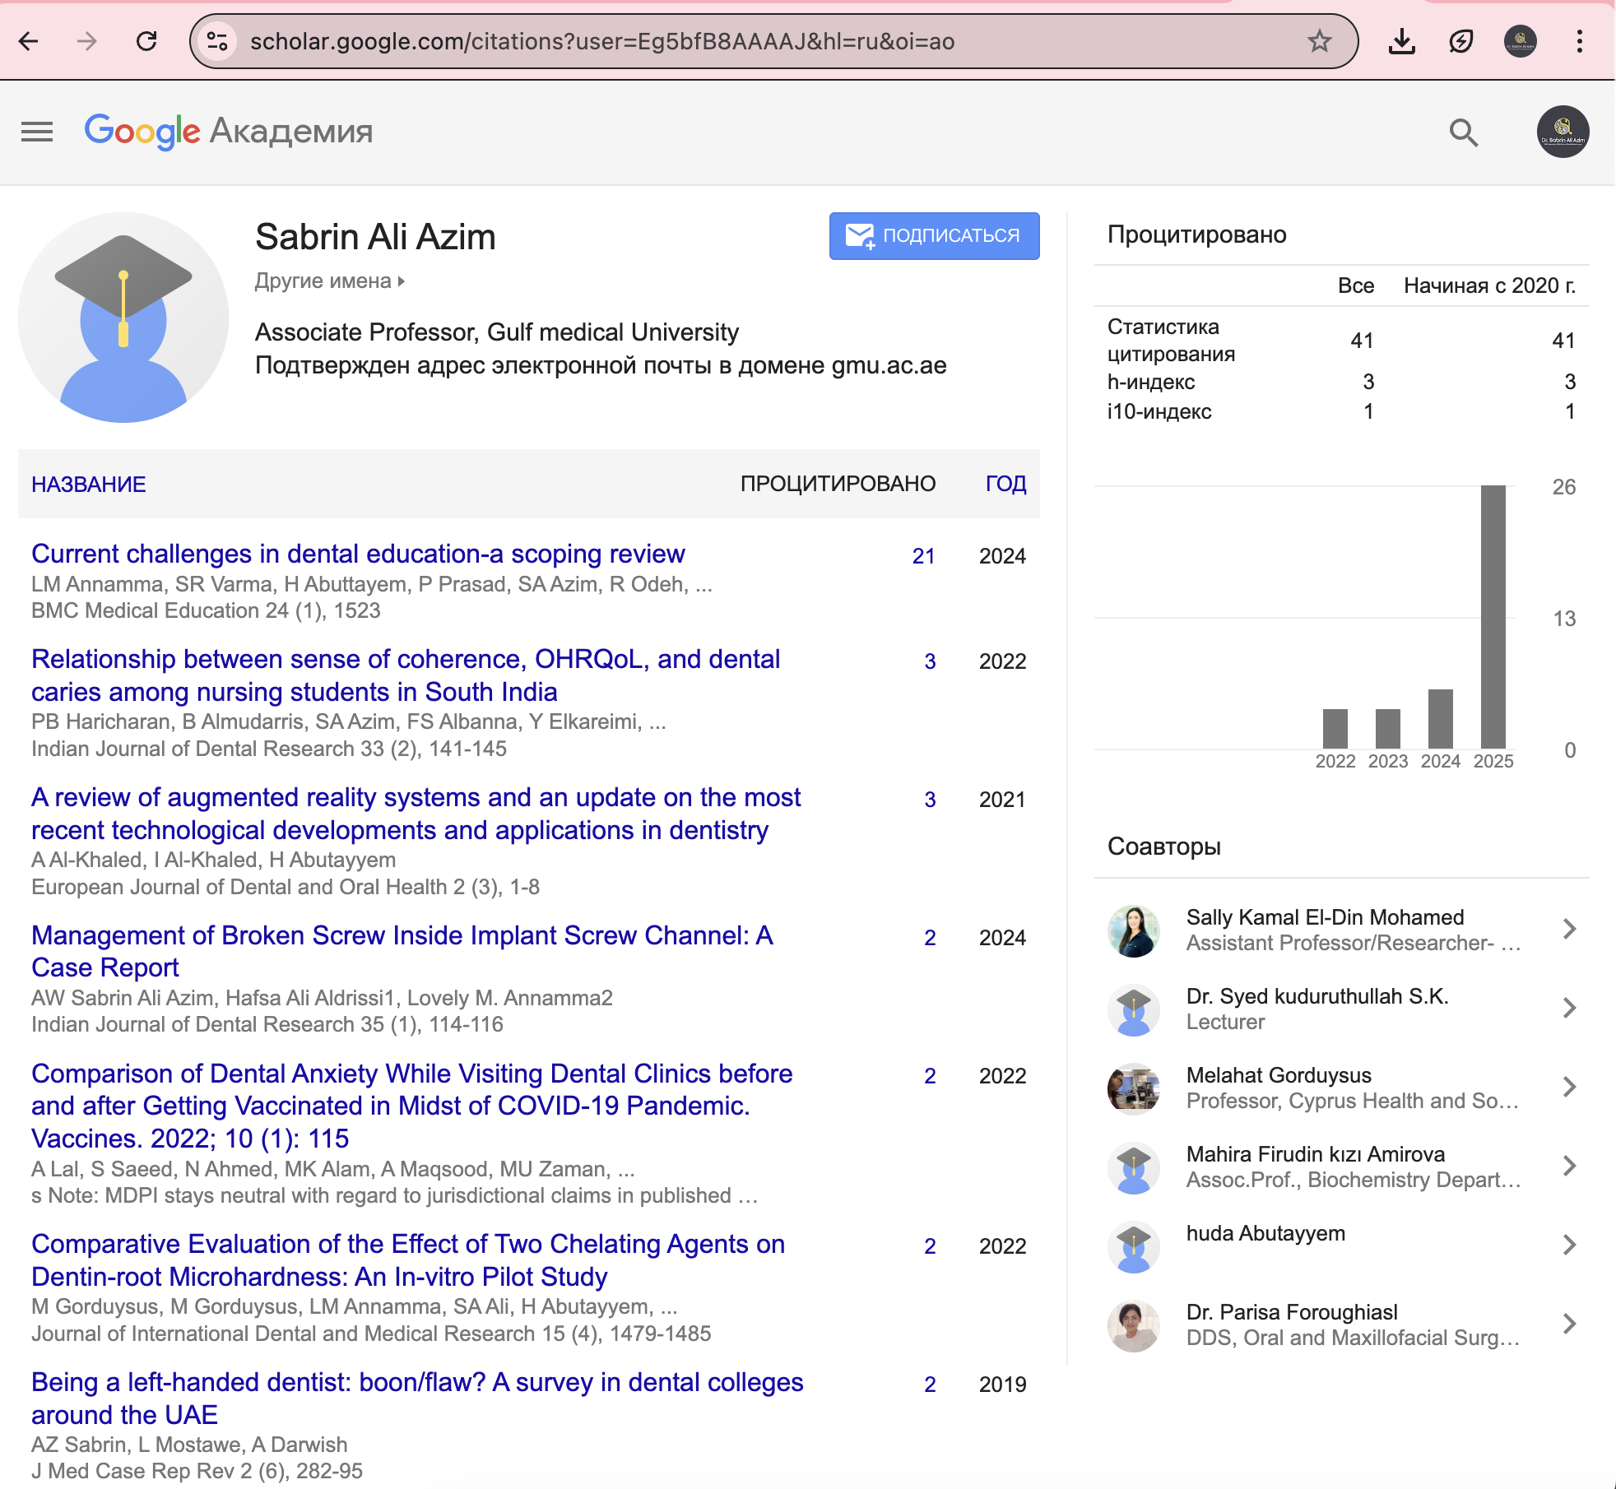
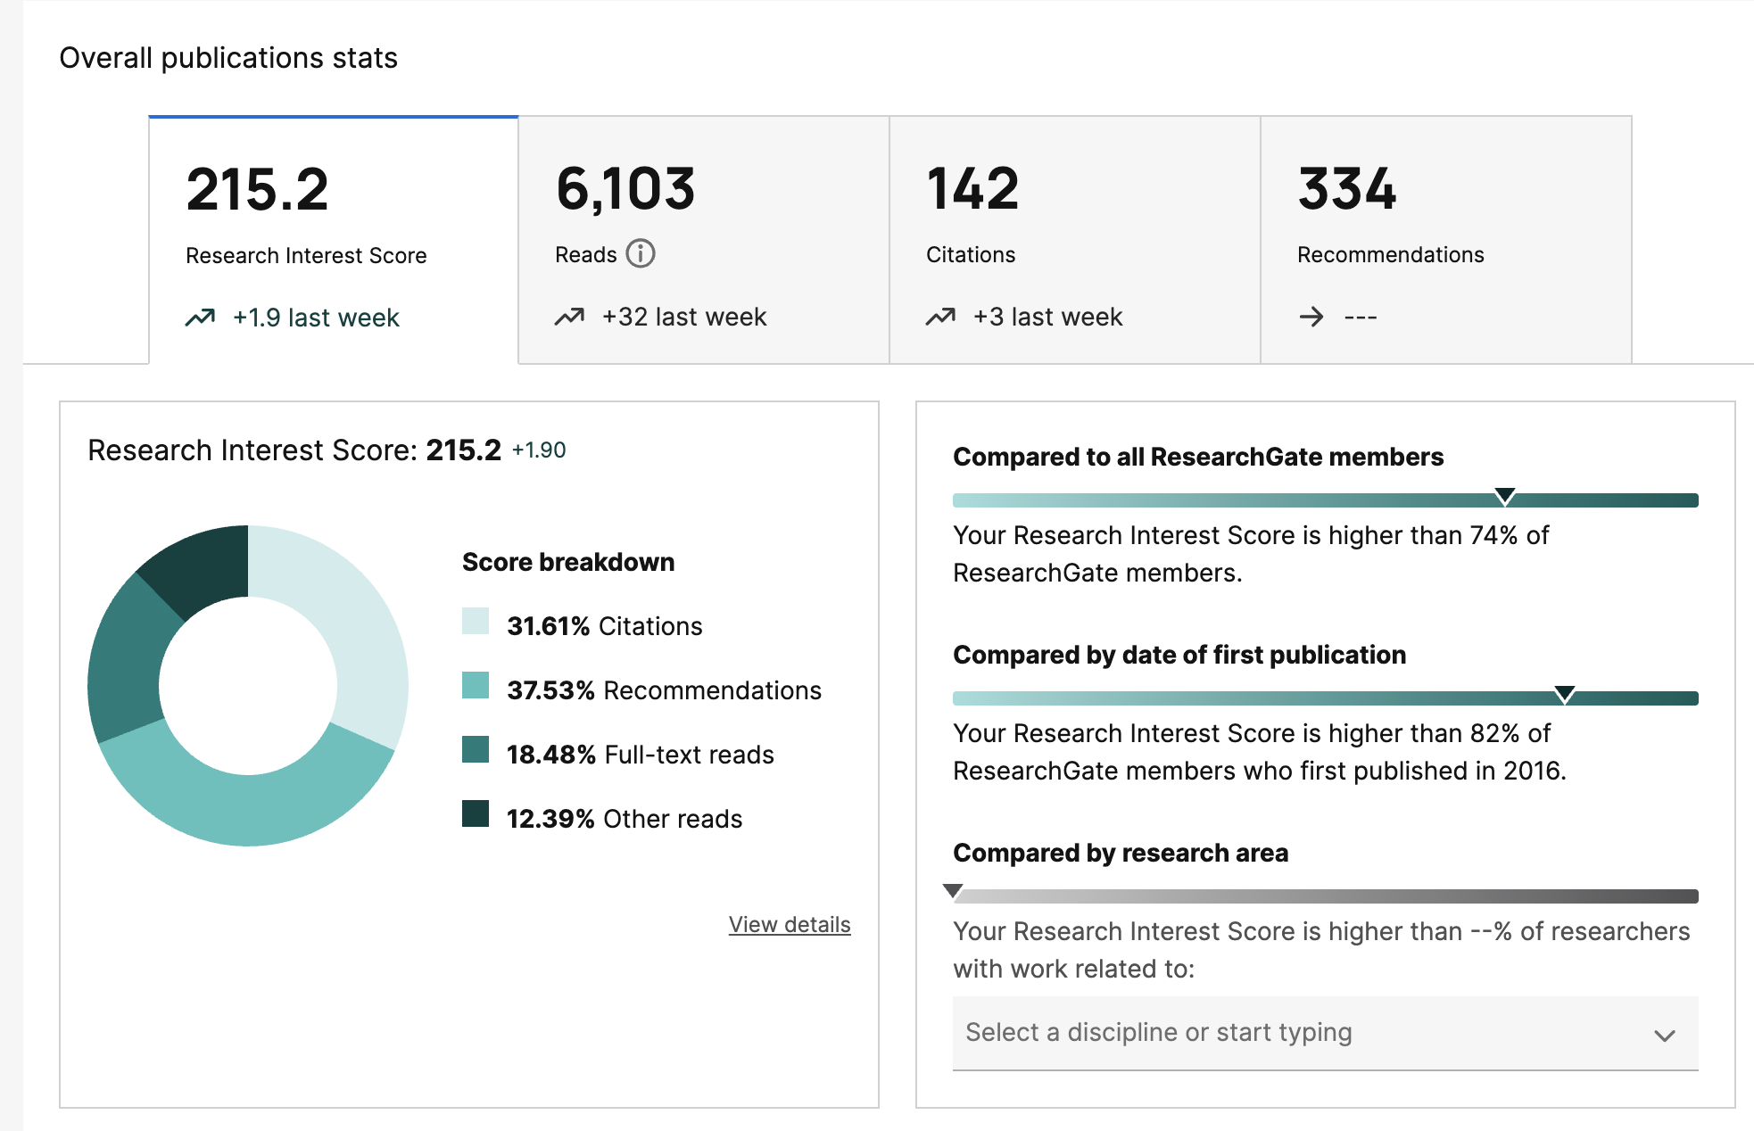
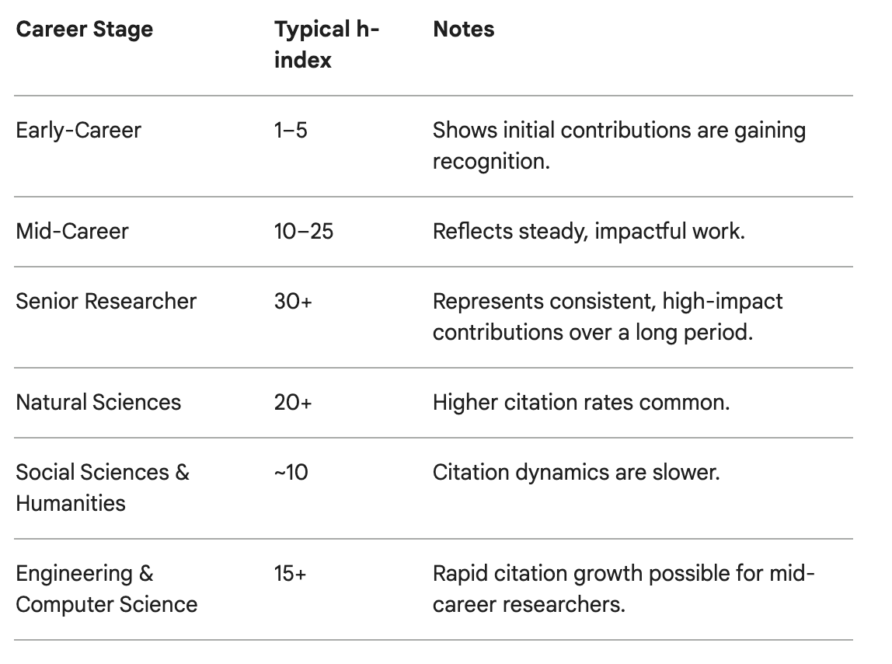
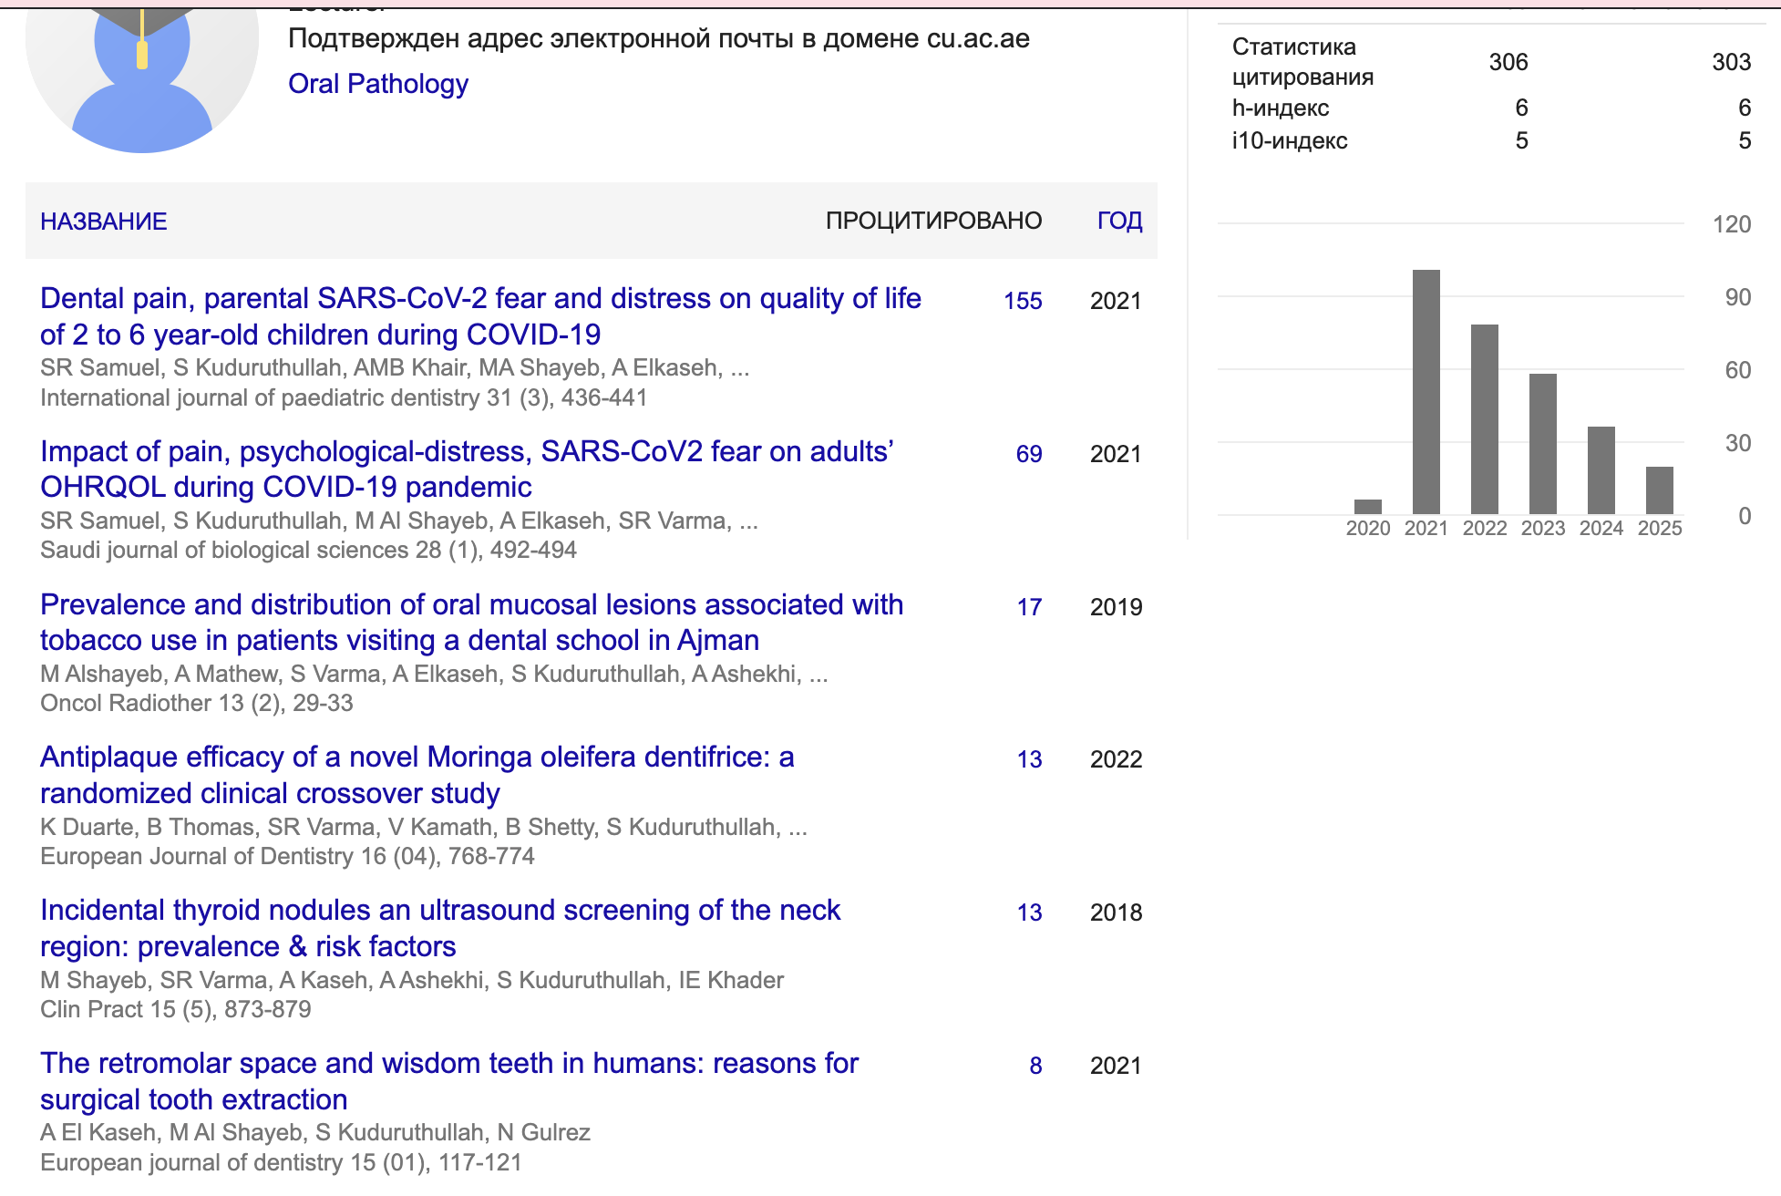

H-index: Measures influence of a researcher.
Impact Factor: Measures a journal’s reputation.
Bias: Any factor that distorts truth.

Slide 11
The H-Index Lesson
Metrics are feedback: which questions became useful to others?
What h-index really means
consistent contribution
If h = 10, the researcher has 10 papers cited at least 10 times each. It rewards sustained usefulness — not one viral paper.
How to use this ethically
• A topic that answers a shared problem can build a citation path.
• A narrow local topic may still be valuable, but needs a transferable lesson.
• Reviews and frameworks often travel because they help many researchers begin.
• Metrics must guide strategy — never replace integrity.
6
5
4
3
2
1
Optional personal line: “When I look at my own H-index, I ask: which questions became useful to others — and why?”
H-index concept: Hirsch-type author-level metric; use with caution because citation cultures differ by field and career stage.
Azerbaijan Research Society • Research Foundations 2026 • Dr. Sabrin Ali Azim

Slide 12
Choose Your Direction — Your Research Title Starts Here
Poll Question | Option 1 | Option 2
Style | 🔬 Modern | 📚 Traditional
Scope | 🌍 Global | 🏥 Local
Focus Area | 🧠 Clinical / Surgical | 💻 AI / Digital Health
Lens | ⚖️ Law / Ethics | 💡 Behavioral / Humanistic
“Vote live for each category and watch your ideal research title form step by step!”

Slide 13
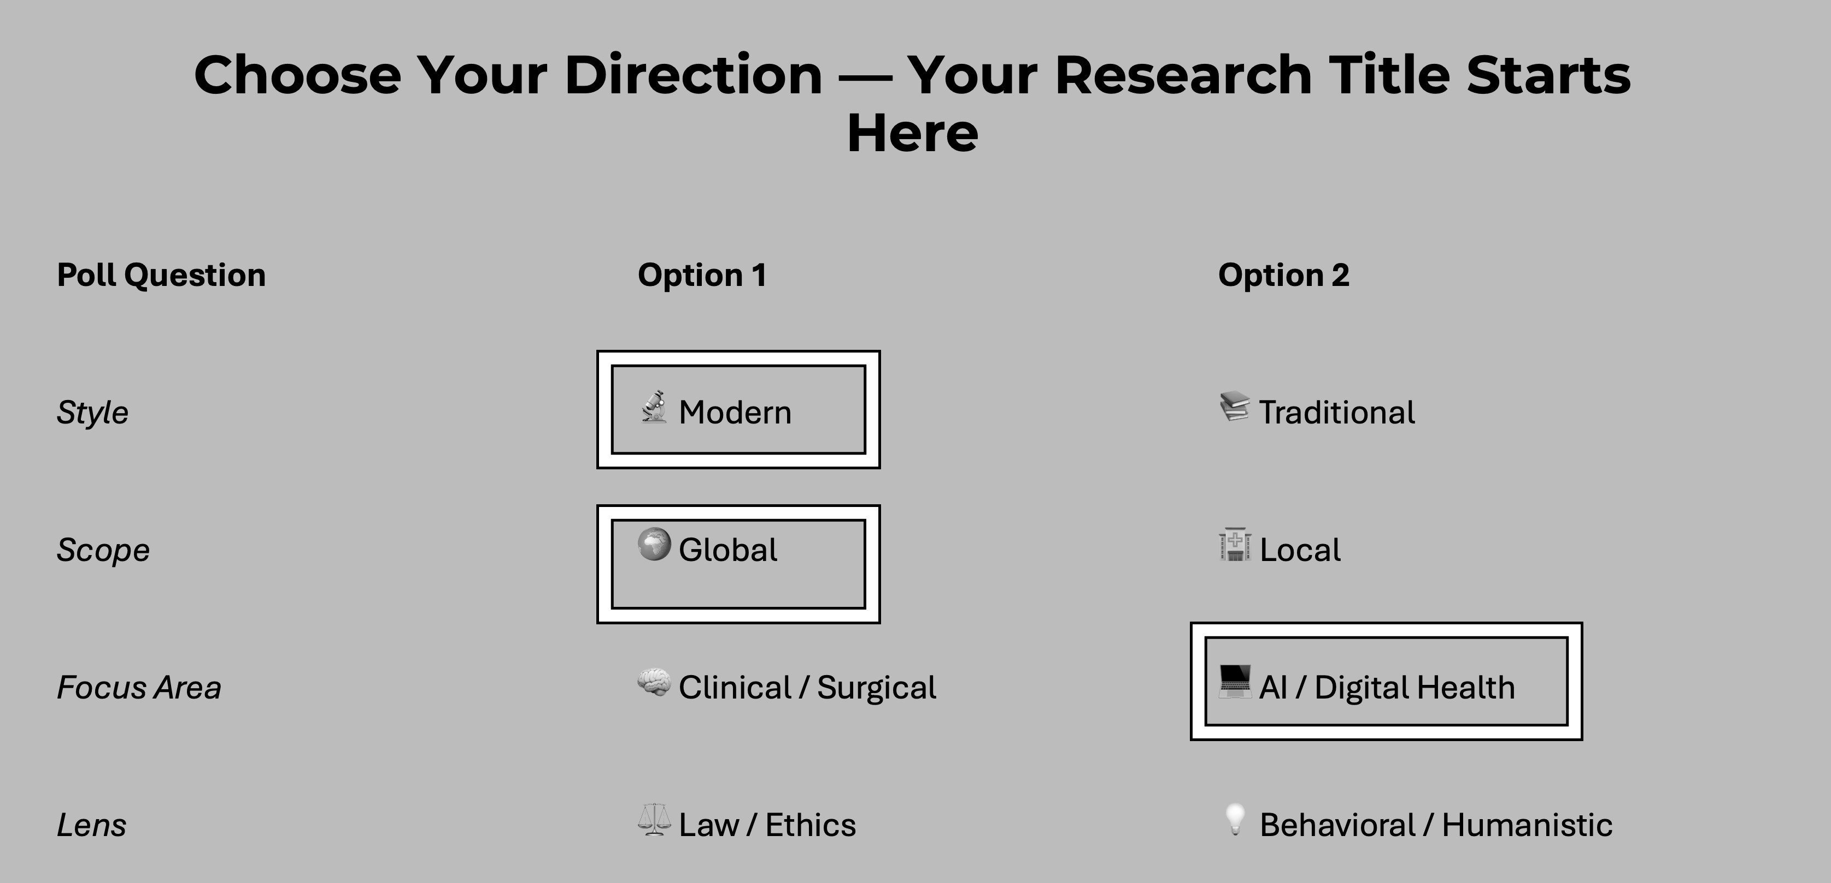
“AI-Driven Global Regulations in Surgical Oncology: Legal and Ethical Perspectives”

Slide 14
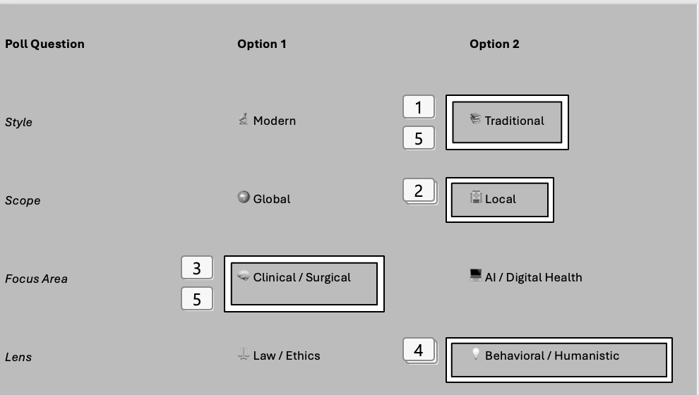
Poll Question | Option 1 | Option 2
Style | 🔬 Modern | 📚 Traditional
Scope | 🌍 Global | 🏥 Local
Focus Area | 🧠 Clinical / Surgical | 💻 AI / Digital Health
Lens | ⚖️ Law / Ethics | 💡 Behavioral / Humanistic
“Clinical Challenges and Patient Perceptions in Post-Radiotherapy Dental Care in Azerbaijan”

Slide 15
How to Find What’s Already Known
Before you research — check what the world already discovered.
Tool | Purpose | Example Search
PubMed | Biomedical studies, clinical trials, systematic reviews. | "AI AND surgical oncology AND ethics"
Google Scholar | Multidisciplinary articles and citations. | "Radiotherapy complications AND insurance liability"
ResearchRabbit / Connected Papers | Visualize article networks and topic evolution. | "AI in healthcare 2020–2025"
🧠 Task: Search one topic you brainstormed earlier.
Find a 2020–2025 article and note:
(a) Title
(b) Study type
(c) What’s missing (gap).
💡 AI Tools You Can Trust
• ChatGPT – Generate ideas or gaps
• Elicit.org – AI for literature discovery
• Scite.ai – Checks citation context (supported vs contradicted)
“Before writing your research question, learn what’s already answered — that’s how you avoid repetition and discover innovation.”

Slide 16
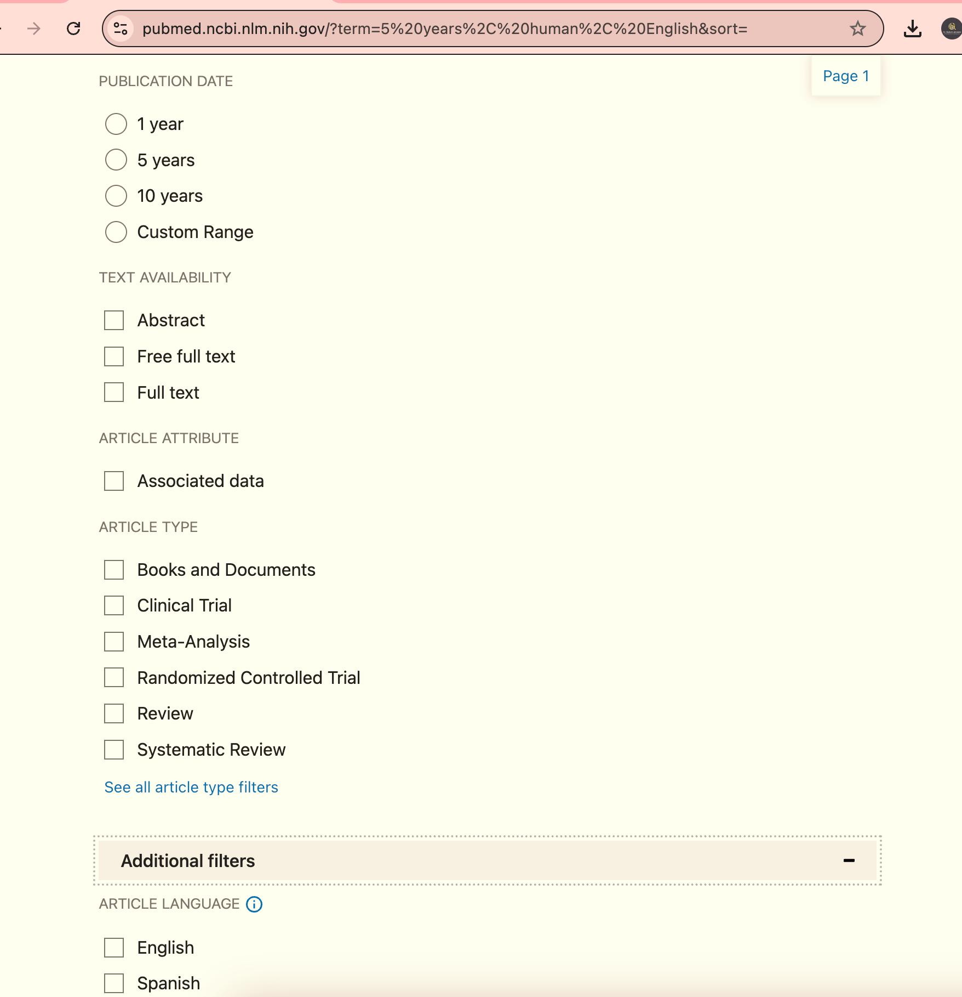
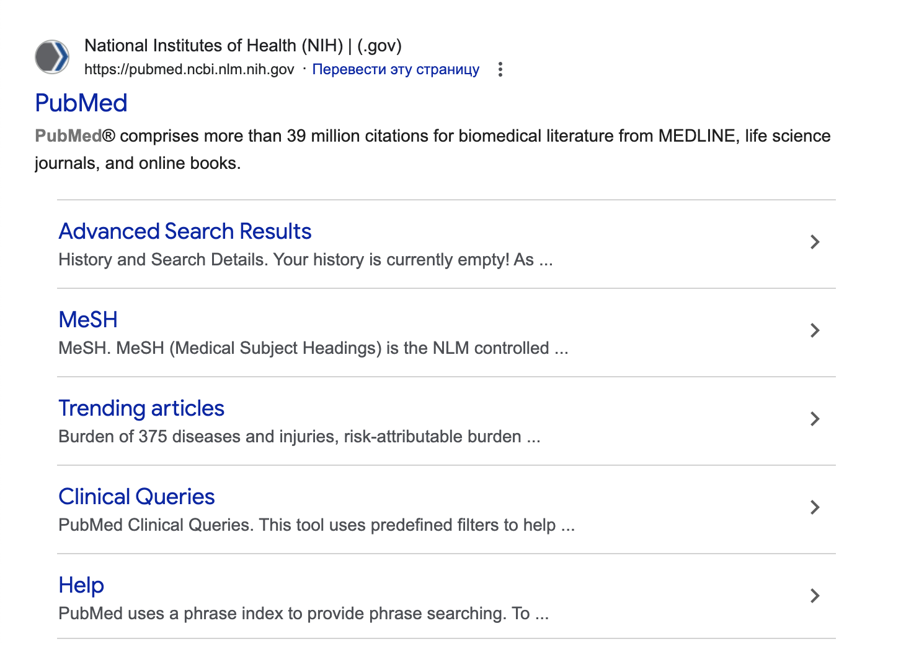

Slide 17
Choosing a Topic Like a Professor
Do not choose only what is trendy. Choose what is relevant, feasible, ethical and publishable.
Scientific gap
Feasibility
Citation potential
Ethics & data
Personal identity
Societal value
Is there a real unanswered question?
Can you access data, tools and time?
Will more than one field care?
Can you protect people, privacy and integrity?
Does this fit your long-term profile?
Can it improve practice, policy or technology?
Score 1–5
Score 1–5
Score 1–5
Score 1–5
Score 1–5
Score 1–5
Teaching point: high-quality topic choice requires alignment between gap, method, resources, ethics, impact and researcher identity.
Azerbaijan Research Society • Research Foundations 2026 • Dr. Sabrin Ali Azim

Slide 18
Collaboration Ideas: Where Disciplines Meet
Azerbaijani students can build stronger research by combining expertise — not by copying one field into another.
Medicine
AI / CS
Law
AI + Medicine + Law
Who is responsible when an AI tool supports a wrong clinical decision?
Engineering + Health + Sustainability
Can low-cost sensors improve early disease detection without increasing environmental burden?
Economics
Economics + Medicine + Policy
Engineering
Does insurance coverage change access to early diagnosis or preventive care?
Rule: collaboration is strongest when each discipline owns a necessary part of the question.
Examples aligned with 2026 research directions: AI governance, data ethics, sustainability, health economics and interdisciplinary implementation.
Azerbaijan Research Society • Research Foundations 2026 • Dr. Sabrin Ali Azim

Slide 19
From Trend to Research Blueprint: 3-Minute Challenge
By the end of this lecture, every student should be able to produce this mini-blueprint.
1
Trend
2
Gap
3
Question
4
Keywords
5
Collaboration
What is moving fast in my field?
What is still unknown or poorly implemented?
What exactly will I ask?
How will databases find my idea?
Which discipline makes it stronger?
Example answer: “AI liability in radiology” → gap: unclear accountability → question: how do future physicians assign responsibility when AI disagrees with clinician judgment?
Use as live Zoom activity: students write one line in chat; presenter selects two and improves them live.
Azerbaijan Research Society • Research Foundations 2026 • Dr. Sabrin Ali Azim

Slide 20
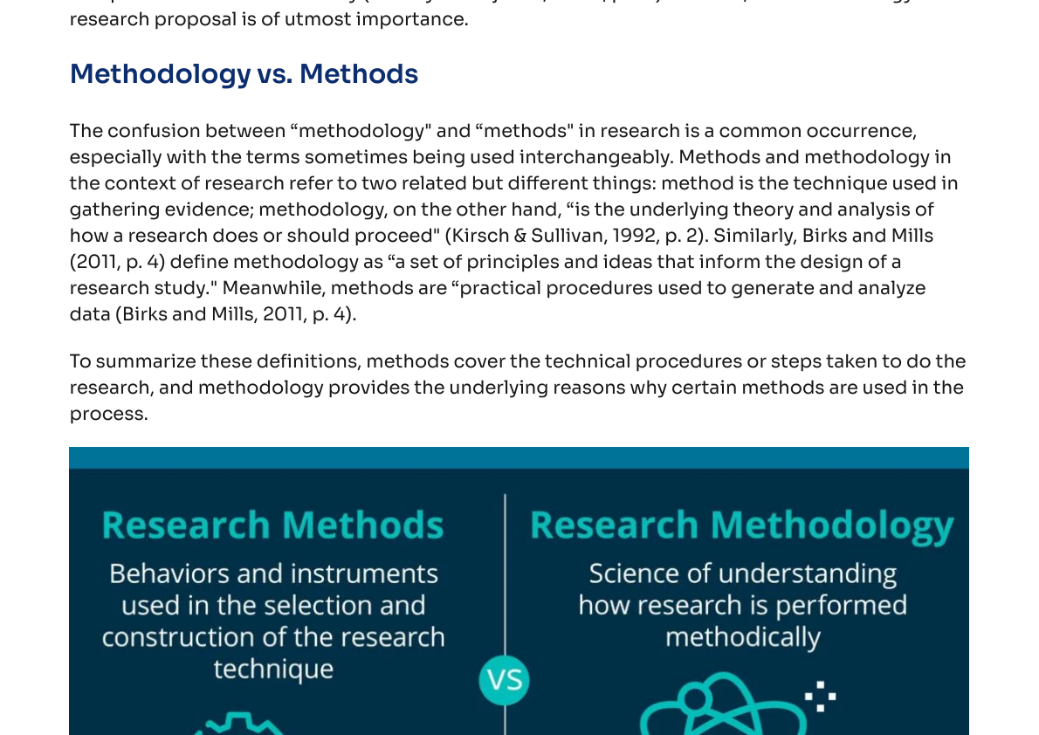
DEFINITION WITH PURPOSE
Research is not “finding information”.
It is reducing uncertainty with evidence.
Assumption
“I think this is true.”
Observation
“I saw this happen.”
Evidence
“I can show how I know.”
Research
“I can explain, test and report it systematically.”
Concept adapted from research-methodology teaching materials: research as systematic inquiry and methodological justification.
AZERBAIJAN RESEARCH SOCIETY • Research Foundations 2026
05

Slide 21
THE LOGIC OF RESEARCH THINKING
Curiosity becomes science only when it becomes structured.
1
2
3
4
5
Curiosity
Problem
Question
Search
Contribution
What do I wonder?
Why does it matter?
What exactly can be answered?
What is already known?
What will I add?
Warning: if you collect data before clarifying the problem and the literature gap, you may produce numbers without meaning.
AZERBAIJAN RESEARCH SOCIETY • Research Foundations 2026
06

Slide 22
FRAMEWORKS ARE NOT DECORATION
A question becomes stronger when the right framework shapes it.
Patient/Problem • Intervention • Comparison • Outcome
Population • Exposure • Comparator • Outcome
PICO
PECO
Clinical trials, interventions, education interventions
Risk factors, environmental exposure, association studies
Sample • Phenomenon • Design • Evaluation • Research type
Feasible • Interesting • Novel • Ethical • Relevant
SPIDER
FINER
Qualitative experience, perception, behaviour, policy
Quality check for almost any research question
The framework does not make the research academic. Alignment makes it academic.
AZERBAIJAN RESEARCH SOCIETY • Research Foundations 2026
07

Slide 23
PRECISION CREATES RESEARCH
A broad topic is not a study. It is only the starting point.
WEAK
STRONGER
How does AI affect healthcare?
Does AI-assisted triage improve diagnostic accuracy for emergency dental infections compared with standard triage?
Too broad • no population • no outcome • no design • no boundary
Population • intervention • comparison • outcome • context
Population
Intervention
Comparison
Outcome
emergency dental infection cases
AI-assisted triage
standard triage
diagnostic accuracy
AZERBAIJAN RESEARCH SOCIETY • Research Foundations 2026
08

Slide 24
INTERDISCIPLINARY RESEARCH STARTS WITH SHARED UNCERTAINTY
If AI gives a wrong clinical recommendation, whose research question, is it?
Ethics / Policy
fairness
regulation
Medicine
AI / IT
patient safety
clinical outcome
model performance
bias • explainability
AI-assisted diagnostic error
Law
Education
liability
consent • privacy
training
trust calibration
Economics
cost-effectiveness
insurance risk
AZERBAIJAN RESEARCH SOCIETY • Research Foundations 2026
09

Slide 25
ARCHITECTURE, NOT DECORATION
A research idea becomes serious when its parts align.
Research question
Does AI-assisted triage improve diagnostic accuracy compared with standard triage?
VARIABLES
Objective 1
Compare diagnostic accuracy between AI-assisted and standard triage groups.
Independent
type of triage
Dependent
accuracy, trust
Objective 2
Assess trainee confidence and perceived trust in the AI recommendation.
Confounders
experience, case severity
Hypothesis
AI assistance improves diagnostic accuracy, but explainability influences user trust.
If the variables are unclear, the methodology cannot be strong.
AZERBAIJAN RESEARCH SOCIETY • Research Foundations 2026
10

Slide 26
LITERATURE REVIEW MINDSET
Do not collect papers. Build an evidence map.
1
2
3
4
5
Known
Uncertain
Missing
Method gap
Your angle
what is established
what is debated
what has not been studied
what was weakly measured
what you add
Weak review
Paper A says… Paper B says… Paper C says…
Strong review
Together, studies reveal a pattern, a limitation and a gap.
AZERBAIJAN RESEARCH SOCIETY • Research Foundations 2026
11

Slide 27
SEARCH STRATEGY BEGINS BEFORE SEARCHING
Keywords are the architecture of your literature review.
Concept A
Concept B
Population / context
Outcome
AI-assisted diagnosis
clinical decision-making
students / clinicians
trust / performance
artificial intelligence
machine learning
algorithm
triage
diagnostic accuracy
risk prediction
medical students
dental students
residents
confidence
error rate
acceptance
Boolean logic example
("artificial intelligence" OR "machine learning") AND (diagnosis OR triage) AND (trust OR confidence) AND (students OR residents)
Tip: adapt database vocabulary by field: MeSH for biomedical searches; IEEE terms for engineering/AI; legal terms for law; subject headings when available.
AZERBAIJAN RESEARCH SOCIETY • Research Foundations 2026
12

Slide 28
LITERATURE SEARCH IS FIELD-SENSITIVE
Where you search determines what you can know.
Medicine / dentistry
PubMed • Scopus • Cochrane • ClinicalTrials.gov
AI / computer science
IEEE Xplore • ACM Digital Library • arXiv • Scopus
Engineering / materials
Scopus • Web of Science • IEEE • ScienceDirect
Education / social science
ERIC • PsycINFO • Scopus • Google Scholar
Economics / business
EconLit • SSRN • policy databases • Scopus
Law / regulation
legal databases • e-qanun • court decisions • policy papers
A literature review is not complete because you searched a lot; it is complete when your search is appropriate for the question.
AZERBAIJAN RESEARCH SOCIETY • Research Foundations 2026
13

Slide 29
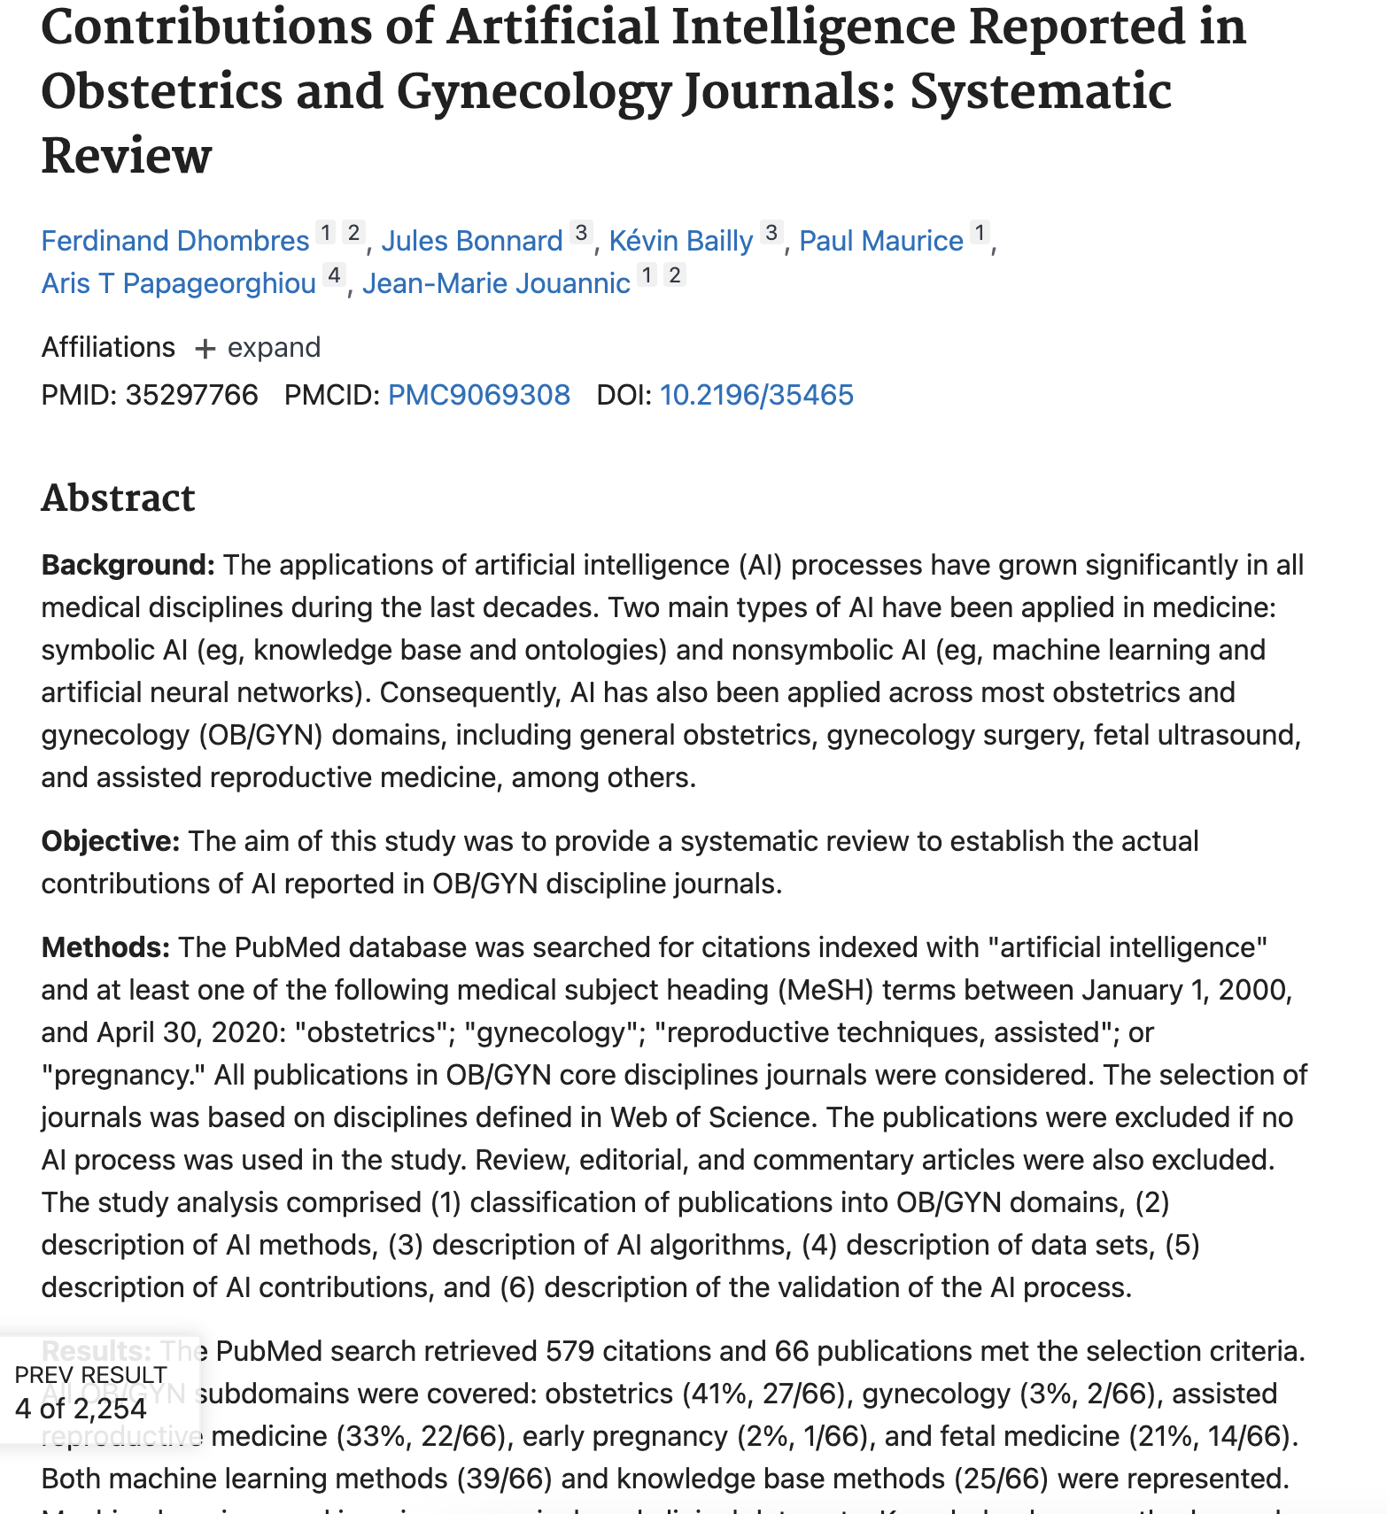
Can you identify the main keywords?”

Slide 30
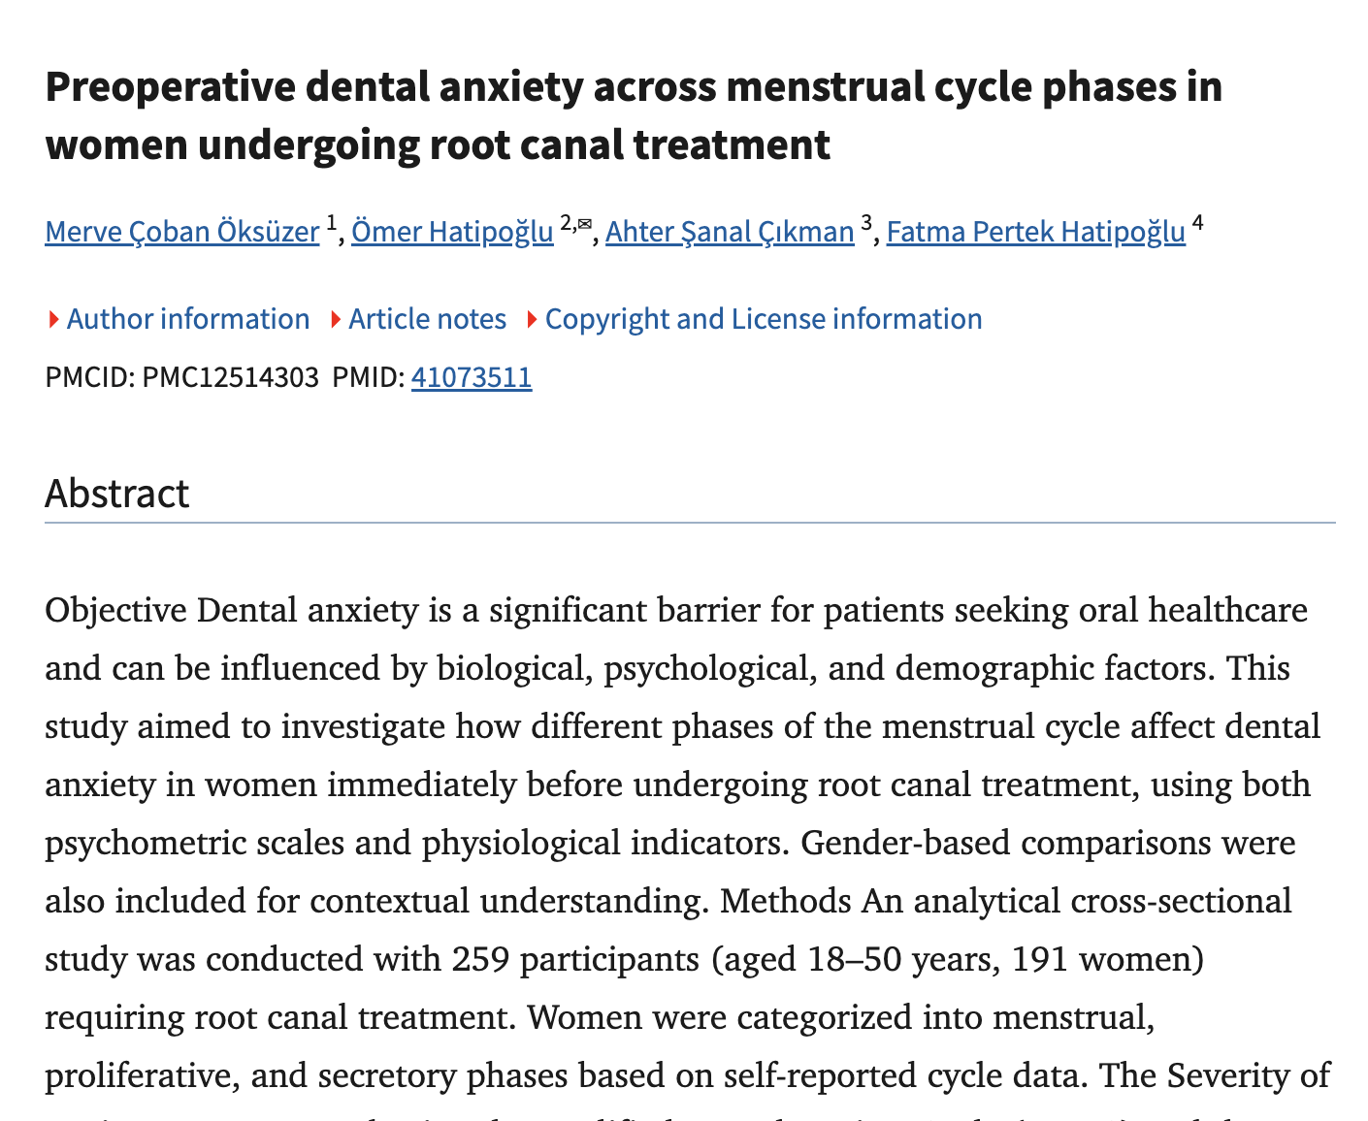
REAL ARTICLE READING
Read titles and abstracts like a researcher, not like a reader.
Population
women undergoing root canal treatment
Exposure
menstrual-cycle phase
Outcome
dental anxiety
Method
analytical cross-sectional study
Gap logic
few studies examine hormonal phase in endodontic anxiety
Example article: Scientific Reports 2025, “Preoperative dental anxiety across menstrual cycle phases…”
AZERBAIJAN RESEARCH SOCIETY • Research Foundations 2026
14

Slide 31
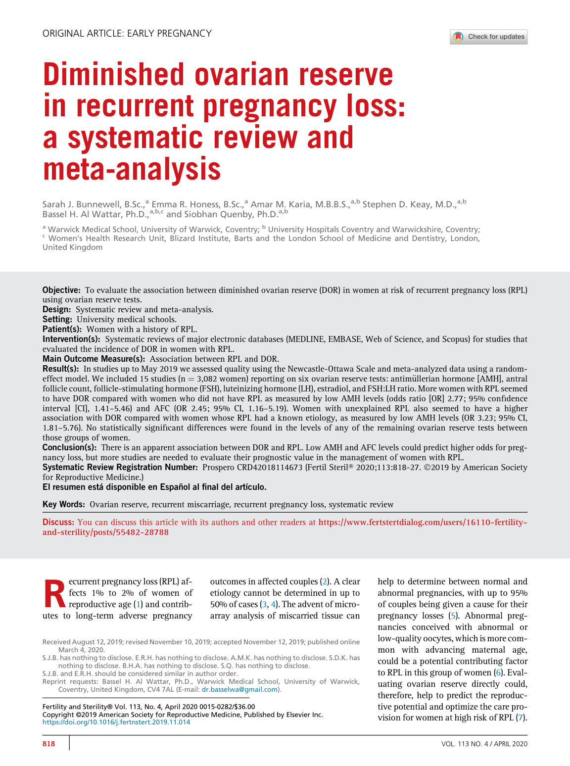
WHEN LITERATURE BECOMES DATA
A systematic review studies the evidence itself.
Objective
association between ovarian reserve and recurrent pregnancy loss
Design
systematic review and meta-analysis
Databases
MEDLINE, EMBASE, Web of Science, Scopus
Outcome
association with diminished ovarian reserve
Value
turns scattered studies into a clearer evidence picture
Example article: Fertility and Sterility 2020 systematic review/meta-analysis on diminished ovarian reserve and recurrent pregnancy loss.
AZERBAIJAN RESEARCH SOCIETY • Research Foundations 2026
15

Slide 32
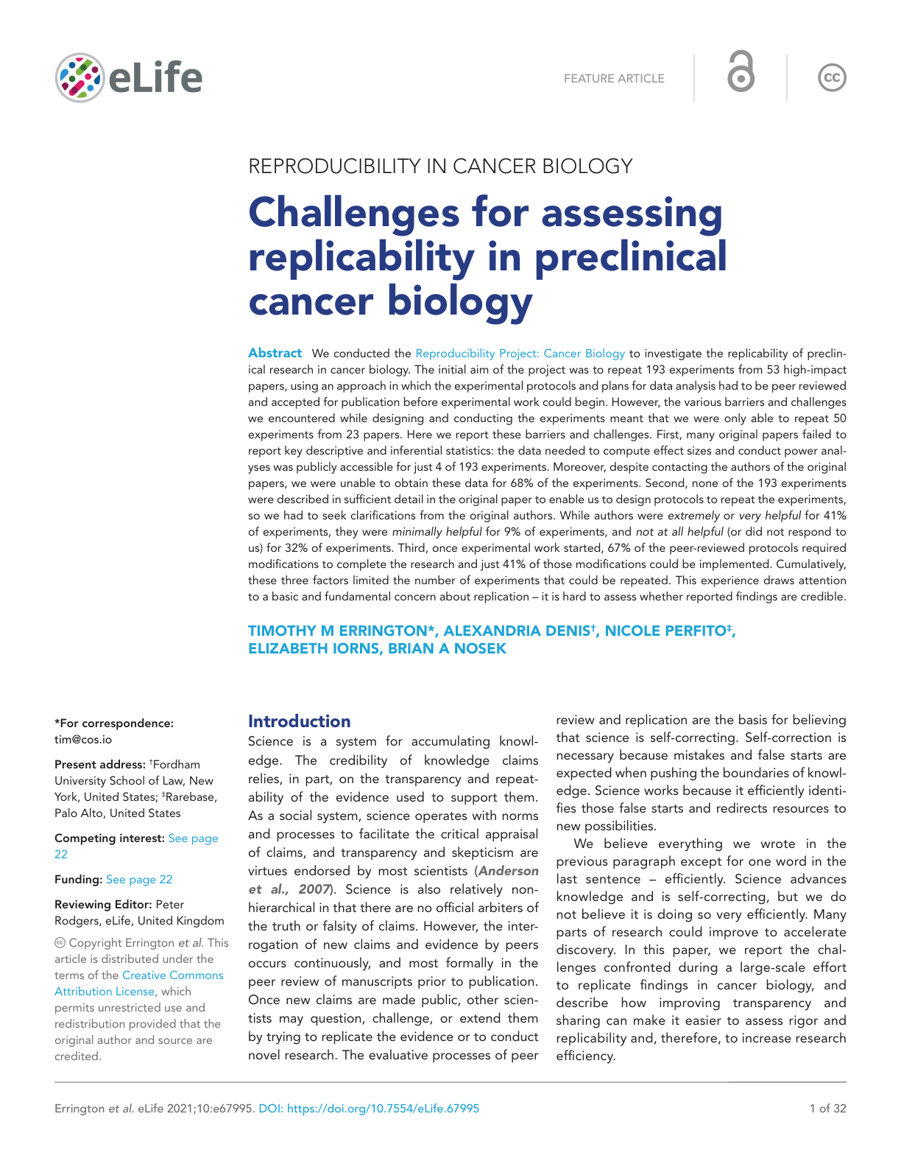
RESEARCH QUALITY AND TRANSPARENCY
A study is stronger when its logic can be inspected.
193
50
4
experiments initially targeted
experiments actually repeated
had public data sufficient for effect-size / power calculations
Research quality begins before the results: clear question, transparent methods, reproducible logic.
Errington et al., eLife 2021: Reproducibility Project in Cancer Biology; reported barriers to assessing replicability.
AZERBAIJAN RESEARCH SOCIETY • Research Foundations 2026
16

Slide 33
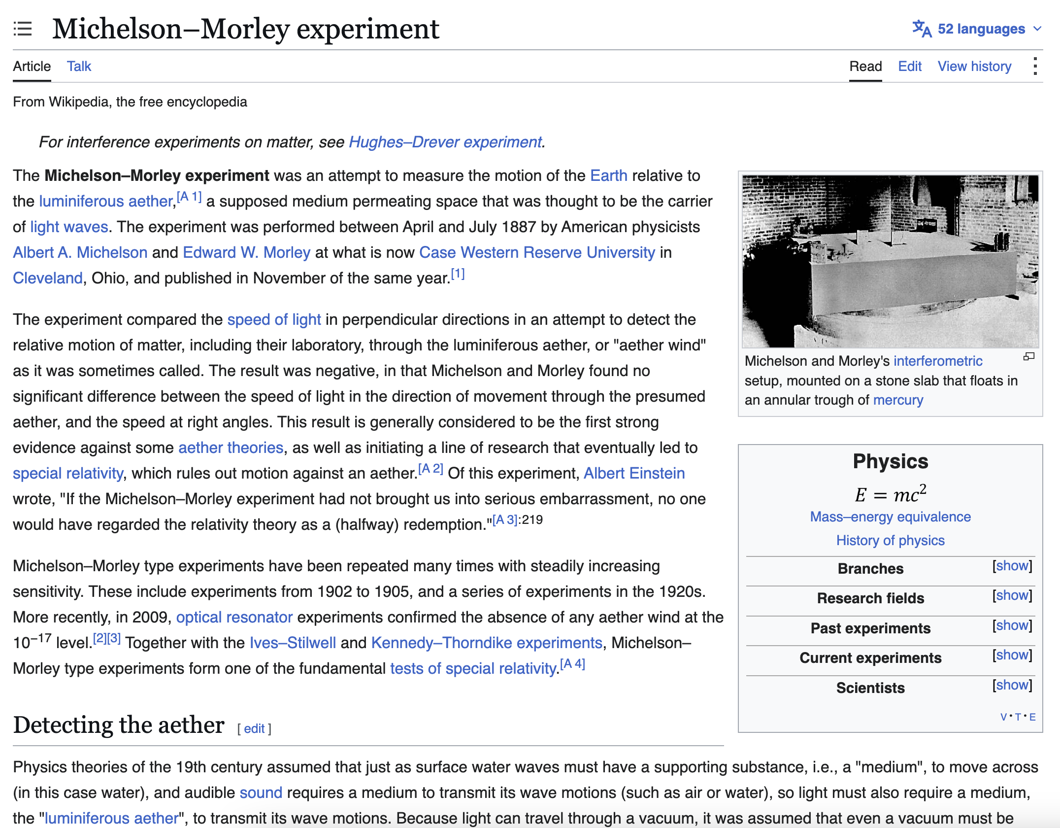
SCIENTIFIC MATURITY
A null result can be noise — or it can be a doorway.
Expected
detect “aether wind” through light-speed differences
Observed
no significant difference in measured speed of light
Meaning
negative finding pushed science to rethink assumptions
Negative results are valuable when the question, design and interpretation are strong.
Historical example: Michelson–Morley experiment, 1887; negative result became important evidence against aether theories.
AZERBAIJAN RESEARCH SOCIETY • Research Foundations 2026
17

Slide 34
2026 SKILL: CRITICAL AI USE
AI can accelerate searching. It cannot carry your responsibility.
USE AI TO SUPPORT
DO NOT USE AI TO SUBSTITUTE
✓
Generate initial synonyms
×
Invent references
✓
Draft search strings
×
Decide credibility alone
✓
Compare abstracts
×
Hide AI use
✓
Create tables for screening
×
Replace human interpretation
Rule for students: AI may suggest; you must verify, cite correctly, and disclose when required.
Compare abstracts
Generate initial synonyms
Hide AI use
Invent references
AZERBAIJAN RESEARCH SOCIETY • Research Foundations 2026
18

Slide 35
WHERE STUDENTS CAN COLLABORATE
The best research teams do not share the same background — they share a problem.
A
Medicine × AI × Law
B
Economics × Health
Who is responsible when AI advice is wrong?
What is the cost of delayed diagnosis?
C
Engineering × Life sciences
D
AI × Education
Can a material or sensor improve safety?
Do students over-trust AI feedback?
E
Law × Data privacy
F
Business × Sustainability
How should consent change with digital health?
Can research innovation scale responsibly?
Interdisciplinary research begins when one question requires several kinds of evidence.
AZERBAIJAN RESEARCH SOCIETY • Research Foundations 2026
19

Slide 36
INTERACTIVE RESEARCH LABORATORY
4 minutes: turn a topic into a research concept.
Topic 1
Topic 2
Topic 3
AI-assisted diagnosis
Student trust in AI feedback
Sustainable medical materials
Possible partner: law, IT, medicine
Possible partner: education, psychology, AI
Possible partner: engineering, chemistry, economics
1
Problem
2
Question
3
Keywords
4
Partner
What matters?
What can be answered?
How will you search?
Who must join?
Write in chat: Topic number + one research question + 3 keywords + one discipline partner.
AZERBAIJAN RESEARCH SOCIETY • Research Foundations 2026
20

Slide 37
WRITING BEGINS WITH LOGICAL ARCHITECTURE
A strong introduction does not define. It guides.
1. Global issue
What is the large problem?
2. Local / disciplinary context
Why does it matter here?
3. Knowledge gap
What is missing or uncertain?
4. Aim / question
What will this study answer?
A review becomes powerful when it leads the reader to one unavoidable question.
AZERBAIJAN RESEARCH SOCIETY • Research Foundations 2026
21

Slide 38
PRACTICAL OUTPUT
One page is enough — if the thinking is clear.
1
Working title
≤ 15 words, focused and specific
2
Research question
answerable, bounded, searchable
3
Two objectives
operational steps, not wishes
4
3–6 keywords
with synonyms or concept blocks
5
Search string
one Boolean search line
6
Evidence gap
what is missing, weak or debated
7
Collaboration angle
which discipline improves the study?
Deliverable: one research question, two objectives and one preliminary search strategy before the next session.
AZERBAIJAN RESEARCH SOCIETY • Research Foundations 2026
22

Slide 39
From Idea to Keywords & Introduction
Step | Example (Clinical Topic: AI in Surgical Oncology)
Define your core concepts | Identify variables: AI, Oncology, Surgery
Derive keywords (MeSH/synonyms) | Artificial Intelligence, Machine Learning, Predictive Models
Write introduction like a story | Start broad → show the gap → state the aim
End with research question | ‘Can AI predict post-operative complications better than surgeons?’
“Your keywords are how the world finds your curiosity.”

Slide 40
10-MINUTE DISCUSSION
Before you start a project, ask better questions about the question.
01
What makes a topic too broad to become a study?
02
How do we know whether a literature gap is real or only a weak search?
03
When should AI help the literature review — and when should it not?
04
Which disciplines should collaborate on AI-related healthcare research?
05
Can a negative result still be publishable or useful?
06
What would make your one-page concept note strong?
AZERBAIJAN RESEARCH SOCIETY • Research Foundations 2026
23

Slide 41
Research identity starts with one better question.
Curiosity → Question → Evidence → Collaboration → Contribution
Good researchers do not memorize more. They connect better, question better and build evidence more responsibly.
Thank you
Discussion and questions
AZERBAIJAN RESEARCH SOCIETY • Research Foundations 2026
Educational material prepared by Dr. Sabrin Ali Azim. Please cite/acknowledge when reused.
24

